Slide 1
Alignment of AMI MDA with the Digital Operating Model and Ways of Working
January 19, 2022
Craig S. Rutfield

Slide 2
AMI Delivery Model Target State
Key Tenets:
Our AMI Delivery Model is Product-Centric
Platform Products will provide the foundational components to enable the AMI Product Lines.
We have re-aligned roles to deliver at the appropriate level: squads, Product Teams or Product Line Teams
DELIVERY
LEADERSHIP
Business Program Owner
IT
Program Owner
TDA
Program Owner
IT Director
Digital Business Design
Business/
TDA
IT
Brian Walsh
Nate Boyce
Governance, Financial Reporting, Vendor Mgmt.
Note: Gray roles indicate the team has not been enabled yet
Carlos Nouel
Simon Baker
Tm Bradford
Spu Rao / David Williams
Digital
Business
Manager
Digital
Product Line
Manager
Digital
Business
Manager
Digital
Product Line
Manager
Digital
Business
Manager
Digital
Product Line
Manager
TBD
TBD
TBD
TBD
PRODUCT LINE
Meter Enablement
Customer Enablement
Grid Enablement
Service Enabling teams
Architecture
Joe Clinchot / Tony Hays .
Regulatory
Kris Kiefer
Security
Jerry Lin
Quality Engineering
Gaurav Rajans
PRODUCT FAMILY
Meter and Field Operations
Meter Analysis
Presentment & Marketplace
Customer Operations
Billing
Grid Operations
Grid Intelligence
Dig Biz Lead
Lead
PM
Dig Biz Lead
Lead
PM
Dig Biz Lead
Lead
PM
Dig Biz Lead
Lead
PM
Dig Biz Lead
Lead
PM
Dig Biz Lead
Lead
PM
Dig Biz Lead
Lead
PM
Mary Ann Burkhardt
Ronnie Chowdary
Bob Lewis
Erick Pangan
SQUADS
organized by products
Other Product Teams
PLATFORM
PRODUCTS
Meter and FAN Field Deployment (Business owned)
OMW
Field Deployment
Lead
Mike Mokey
Network Lead*
Doug Page
Meter Data Acquisition
Business Lead
ADMS
Meter Data Acquisition (IT owned)
Neeru Somiah
Digital Product
Director
Craig Rutfield
Others...
*NOTE: IT Leadership support role for the Meter and FAN Field Deployment will be filled by the Network Lead.

Slide 3
AMI Delivery Model: Expanded Target State
Our AMI Delivery Model is Product-Centric; Platform Products will provide the foundational components to enable the AMI Product Lines. We have re-aligned roles to deliver at the appropriate level: squads, Product Teams or Product Line Teams
DELIVERY
LEADERSHIP
Business Program Owner
IT
Program Owner
TDA
Program Owner
IT Director
Digital Business Design
Business/
TDA
IT
Brian Walsh
Nate Boyce
Governance, Financial Reporting, Vendor Mgmt.
Note: Gray roles indicate the team has not been enabled yet
Carlos Nouel
Simon Baker
Tm Bradford
Spu Rao / David Williams
Digital
Business
Manager
Digital
Product Line
Manager
Digital
Business
Manager
Digital
Product Line
Manager
Digital
Business
Manager
Digital
Product Line
Manager
TBD
TBD
TBD
TBD
PRODUCT LINE
Meter Enablement
Customer Enablement
Grid Enablement
Service Enabling teams
Architecture
Joe Clinchot / Tony Hays .
Regulatory
Kris Kiefer
Security
Jerry Lin
Quality Engineering
Gaurav Rajans
PRODUCT FAMILY
Meter and Field Operations
Meter Analysis
Presentment & Marketplace
Customer Operations
Billing
Grid Operations
Grid Intelligence
Dig Biz Lead
Lead
PM
Dig Biz Lead
Lead
PM
Dig Biz Lead
Lead
PM
Dig Biz Lead
Lead
PM
Dig Biz Lead
Lead
PM
Dig Biz Lead
Lead
PM
Dig Biz Lead
Lead
PM
Mary Ann Burkhardt
Ronnie Chowdary
Bob Lewis
Erick Pangan
SQUADS
organized by products
Other Product Teams
PLATFORM
PRODUCTS
Meter and FAN Field Deployment (Biz)
OMW
Field Deployment
Lead
Mike Mokey
Network Lead*
Doug Page
ADMS
Meter Data Acquisition (IT)
Others...
Digital Biz Lead
Backhaul Network
Data platform
Integration platform
Environment platforms
Architecture
Security
Neeru Somiah
Digital Product
Director
Craig Rutfield
*NOTE: IT Leadership support role for the Meter and FAN Field Deployment will be filled by the Network Lead.

Slide 4
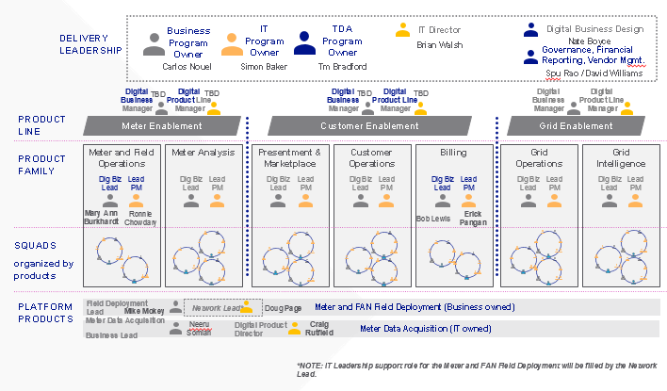
What challenges have we encountered?
Challenge
The role of the MDA platform and managing its work in Jira has differing/misaligned understandings based on the (Product) Delivery Model
Root Causes
The Platform Products are not products. They are product lines of product families of products
MDA is not a product. It is a product line of AMI enabling platforms
MDA’s customers are not end users, so it is often difficult to communicate business value. The consumers are other digital products who require MDA features to provide business value.
Example: The Data Platform is a product family comprised of data products, including: Data model, Data Access Services, and Meter Data

Slide 5
How can we better communicate what MDA is?
Agree upon Fundamentals across National Grid, not solely IT and AMI:
Products
A Product is sustained and will exist continuously.
It is never considered ‘done’ as it will always evolve
A Product is comprised of Features
Features (and enablers)
Features may take more than 1 sprint
Features should not take more than 1 PI
mitigated by smaller features with a dependency across PIs
Quality Engineering validates the feature meets the documented requirements
A feature is comprised of Stories
Stories
Each Story should be less than a sprint
mitigated by making smaller stories
The stories are the all the tasks required for the feature and must be estimated
By estimating effort for each story at the task level, one can determine the effort for each feature modification. Without that, date forecasts would be far less accurate.
Root Causes
The Platform Products are not products. They are product lines of product families of products
MDA is not a product. It is a product line of AMI enabling platforms
MDA’s customers are not end users, so it is often difficult to communicate the business value. The consumers are other digital products who require MDA features to provide business value.
Example: The Data Platform is a product family comprised of data products, including: Data model, Data Access Services, and Meter Data

Slide 6
Solution: MDA Product Line and Product Families (a.k.a. AMI Enabling Platforms)
Align the delivery model with the product model
IT
Business
Digital
Business
Manager
Digital
Product Line
Manager
PRODUCT LINE
Meter Data Acquisition (AMI Enabling Platforms?)
PRODUCT FAMILIES
Architecture
Security
Backhaul Network
Data Platform
Integration Platform
Environment Platforms
Solution Vision
Solution Design
Logical Solution Architecture
Physical Technical Model
Test Infrastructure
Vendor Compliance
Dev env compliance
Test env compliance
Stage env compliance
Prod env compliance
PWG
Carrier Connections
Cellular
MPLS
VRF
VPN
Network Management
CIM transformation
Data Model
Access Services
Environment configuration
CSS Billing file
Snowflake
Azure Blob
EventHub
GoAnywhere file transfers
Mule APIs
Dev env
Test env
Stage env
Prod env
Code Migration (DevOps)
PRODUCTS
*NOTE: Data and Integration products are consumed by other digital efforts in the company and must be managed consistently to enable common platforms.
MDA’s customers are not end users, so it is often difficult to communicate the business value. The consumers are other digital products who require MDA features to provide business value.

Slide 7
Products in Jira: alignment via mapping
How Work is Organized – Product Lines Focus
Essential SAFe JIRA Boards Structure
Product Line
Product Family
Product Family
Product
AMI
Product Line
Product
Feature*
Enabler*
User Story
User Story
User Story
User Story
Example (illustrative)
Product Lines and Product Families are “containers” for the work
Customer Enablement
Portfolio
Billing
Planning is focused on Products and their associated Features*
Products Target Timeframe: between 3 Program Increments (30 weeks) and 1 year
Features Target Timeframe: 1 Program Increment (10 weeks)
Program
Upstate NY Residential Standard Billing
MDMS Sends Register Reads to CSS (Residential Electric)
MDMS shall push billing extract to CSS with register reads for basic residential customers based on the billing calendar
Work happens at the User Story Level
Stories Target Timeframe: user stories are completed in 2-week sprints
Team
*NOTE: Digital Business Design Acceptance Criteria populates product backlog at the Feature level

Slide 8
How does work get done?
PI planning is at the product and feature level.
Management can focus at that level to track progress
Adhering to this JIRA structure also provides access to corporate JIRA reports including JIRA Align (a different tool) which can cut across projects
Sprint Planning is at the feature/enabler/story level
This is primarily “the boots on the ground” daily tasks
DevOps will design and deliver the mechanism (ideally automated) to migrate features across environments once they are approved in the given tier.

Slide 9
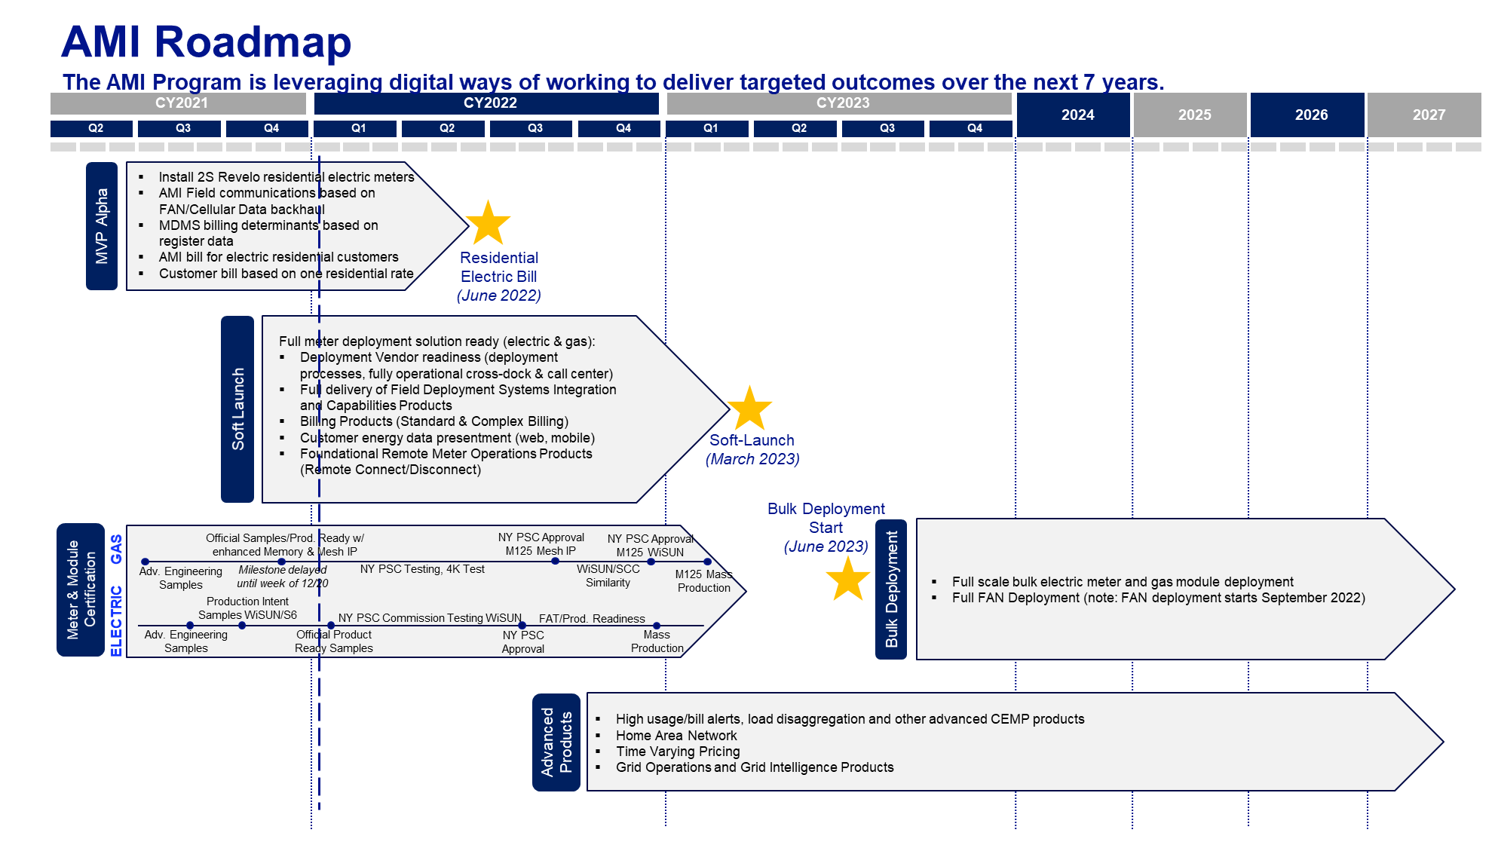
Should we use this for roadmap planning?
Recommendation
Have the roadmap show anticipated/desired products and feature availability and have them mapped directly to JIRA
Value
Everyone will have a view to see progress verse plan whenever they want
One can prioritize work based on projected development duration and delivery timeframe
One can color code the tier (dev, test, production) for each item as current roadmap has a mixture and it is unclear as to when something is ‘ready’.

Slide 10
Q&A

Slide 11
All Digital Products/Families By Product Lines*
Business
IT
Digital
Business
Manager
Digital
Product Line
Manager
Digital
Business
Manager
Digital
Product Line
Manager
Digital
Business
Manager
Digital
Product Line
Manager
PRODUCT LINE
Meter Enablement
Customer Enablement
Grid Enablement
PRODUCT FAMILIES
Meter and Field Operations
Meter Analysis
Presentment & Marketplace
Customer Operations
Billing
Grid Operations
Grid Intelligence
Dig Biz Lead
Lead
PM
Dig Biz Lead
Lead
PM
Dig Biz Lead
Lead
PM
Dig Biz Lead
Lead
PM
Dig Biz Lead
Lead
PM
Dig Biz Lead
Lead
PM
Dig Biz Lead
Lead
PM
Field Deployment Systems Integration and Capabilities
Meter Reading
Disconnect / Connect
Remote Meter Configuration
HAN/In-Home Device Integration
Theft and Tamper
Remote Meter Investigation / Verification
Revenue Assurance Protection
Events and Alarms
Energy Insights (CEMP)
Energy Insights (SENSE)
HAN/In-Home Device Enablement
Opt Out
Customer Communications
Meter Health Status Check
Customer Analytics
Standard Billing
Complex Billing
Load Research and Settlement
Time Varying Pricing
Critical Peak Pricing / Demand Response
VVO/CVR
Outage Restoration and Notification
Meter Ping/Health Status Check
Bell weather Meter
3rd Party Device Integration
Grid Forecasting
Enhanced Data Latency
Advanced Grid Data Analytics
Load Control
Location Awareness
Intelligent Voltage Monitoring
Transformer Health Analysis
Micro-Arc Detection
DER Submetering/Disaggregation
Autonomous DERMS Integration
PRODUCTS
Network Lead
Meter and FAN Field Deployment
Field Deployment
Lead
PLATFORM
PRODUCTS
Products
Meter/FAN Procurement
Meter/FAN Inventory Management
Asset Testing
Asset Lifecycle Management Meter/FAN Installation
Meter & FAN Maintenance
Meter Approval
FAN Design/Optimization
Meter Data Acquisition
Business Lead
Digital Product
Director
Meter Data Acquisition (serves all data to product teams) including HES / MDMS configuration
Products
Meter Program Development
Network Design/Optimization
HES/MDMS Configuration
Architecture & Design
Environment Stand Up
Data Management/Integration Strategy
*NOTE: The Products in bold are the MVP Alpha scope of work.

